Slide 1
App Development
GEIQ Hackathon 2018

Slide 2
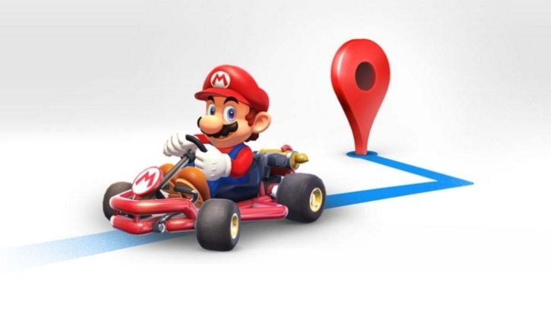

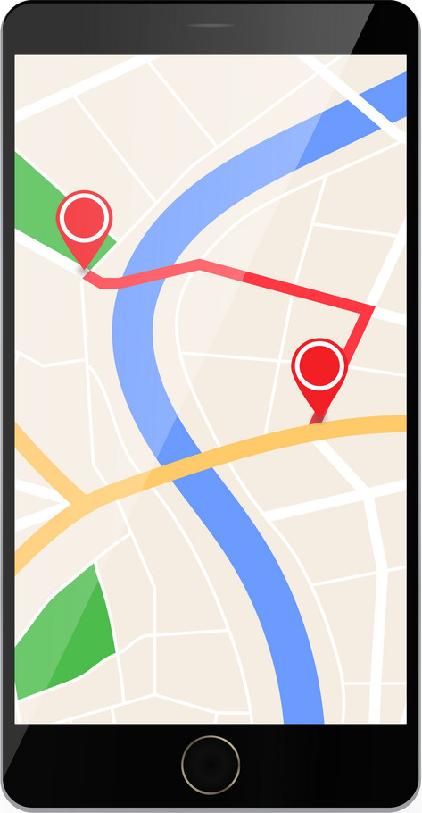
The challenge There is a route and passengers waiting for the bus at different points in the city. You need to architect, design and code a mobile solution for the bus driver and also the passengers. The bus driver has to open the application to start broadcasting its location as long as it is open. The passenger has to be able to check in a map the current location and route of the bus, and its estimated time of arrival to the nearest passenger’s bus stop. The challenge will be divided like this: > Bus driver app > Passenger app > Backend service to receive and broadcast location Have fun!
Scoring
Evaluation Criteria | Points
Presentation | 20
Transmitter app
Simulate entire route in 1 min | 20
(check that broadcasts coordinates, real time vs API)
Passenger app
Correctly display drivers position in map | 20
Correctly display estimated time of arrival | 10
Ability to install app in another device | 10
Design & Usability UI/UX | 20
Bonus!
Use of GitHub repositories | 5
Upload your broadcast service to a cloud service | 10
The spirit of this challenge is to learn, please avoid copy code from another authors

